Slide 1

Trading Performance Analysis: Fear vs Greed
Analyzing 479 trading days across sentiment regimes to uncover profitable patterns in cryptocurrency markets.

Slide 2
DATA FOUNDATION
Dataset Overview
Analysis Period
Bitcoin Fear & Greed Index
Hyperliquid Trader Data
After timestamp alignment and date normalization, 479 overlapping trading days were identified for sentiment-performance comparison.
2,644 records tracking daily market sentiment from Feb 2018 to May 2025. No missing values.
211,224 trade records with 16 metrics including PnL, fees, and direction from May 2023 to May 2025.
Key metrics engineered: Total Daily PnL, Net PnL, Win Rate, Trade Frequency, and Bullish vs Bearish Ratio.

Slide 3

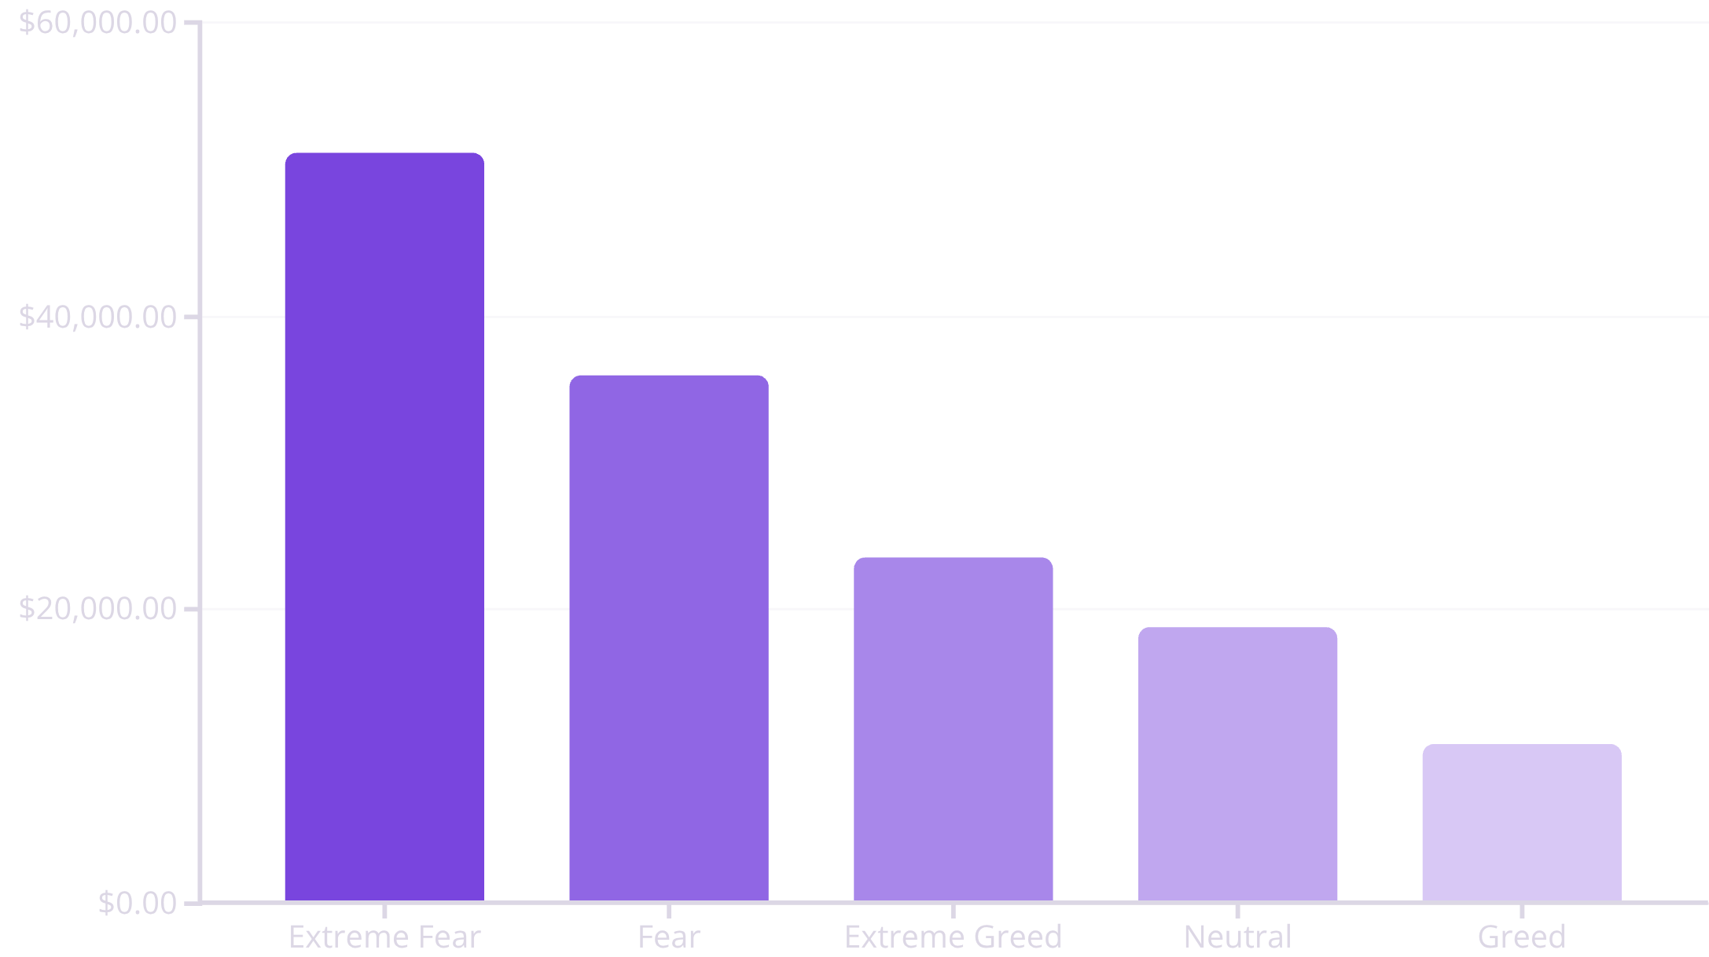
KEY FINDING
Fear Drives Higher Profitability
Volatility Creates Opportunity
Extreme Fear days generated $51,087 average net PnL—nearly 5x higher than Greed days ($10,813). Fear regimes also showed 1,529 average trades versus 261 during Greed.
Despite Extreme Greed having a 46.7% win rate, overall profitability remained lower, suggesting volatility during panic creates superior profit opportunities.

Slide 4

Contrarian Behavior Patterns
Bullish During Fear
Bearish During Greed
Bull/Bear Ratio: 1.85 during Extreme Fear. Traders buy aggressively during panic, positioning for recovery.
Bull/Bear Ratio: 0.75 during Greed. Short-biased positioning dominates as optimism peaks.
Activity Correlation
Trade activity shows 0.35 positive correlation with profitability—higher volume during volatile periods drives profits.

Slide 5



ACTIONABLE INSIGHTS
Three Strategic Recommendations
Increase Exposure During Fear
Reduce Aggression During Greed
Activity-Based Adjustment
When daily trading activity spikes, increase capital allocation and volatility exposure to capture profit opportunities.
Boost trade frequency, widen take-profit targets, and allocate higher capital when sentiment shows Fear or Extreme Fear.
Lower leverage, decrease trade frequency, and favor short-biased setups during Extreme Greed periods.

Slide 6
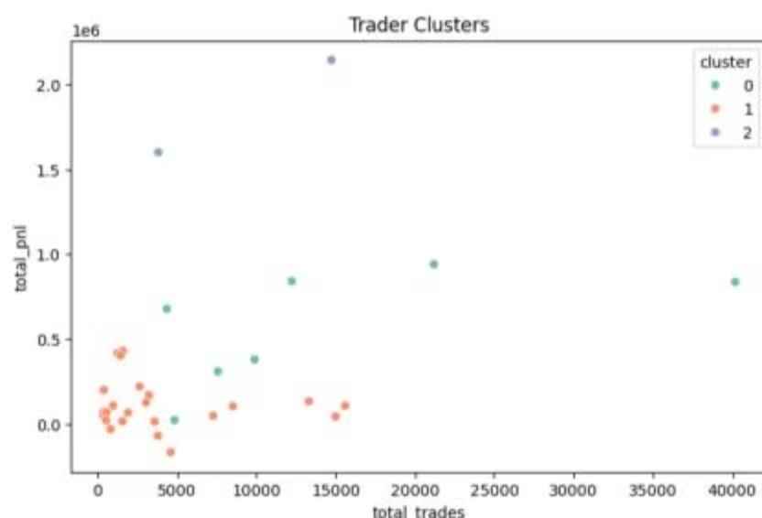
Predictive Modeling & Trader Clustering
Model Performance
Logistic regression achieved 77% accuracy predicting next-day profitability using sentiment value, trade count, win rate, and previous PnL.
Trader Archetypes
Cluster 0: High-frequency, high-volume traders
Cluster 1: Low-activity conservative traders
Cluster 2: Moderate activity, consistent profitability
Behavioral segmentation enables tailored risk management strategies.

